Slide 1
Project 2: E-news Express Project
Data Science and Business Analytics
Krithika Srinivasan

Slide 2
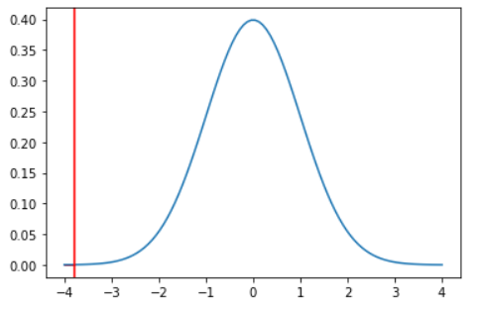
Question 1
Do the users spend more time on the new landing page than the old landing page?
Yes, there is enough evidence to say that users spend more time on the new landing page than the old page
Statistical test used: T test

Slide 3
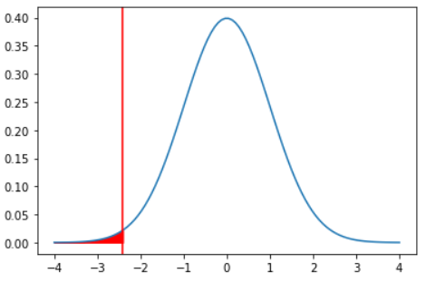
Question 2
Is the conversion rate (the proportion of users who visit the landing page and get converted) for the new page greater than the conversion rate for the old page?
We do not have enough evidence to say that the conversion rate for the new page is greater than the conversion rate for the old page
Statistical test used: 2 proportions Z test

Slide 4
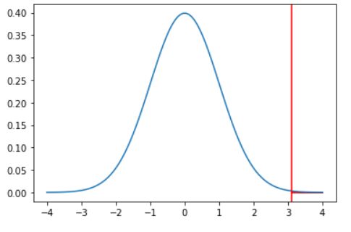
Question 3
Does the converted status depend on the preferred language?
No, the converted status and the preferred language are independent
Statistical test used: Chi-squared test for independence

Slide 5
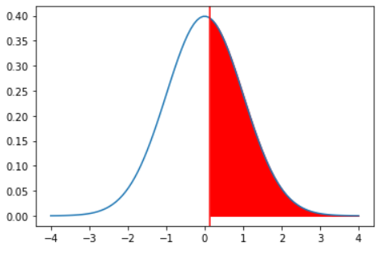
Question 4
Is the mean time spent on the new page same for the different language users?
There is not enough evidence to say that the population means are different than one another
Statistical test used: One-way Anova

Slide 6
Key Insights
From the first test, we see that users spend more time on the new landing page
However, from the second test, we see that the conversion rate for the new page is not higher than the old one
From the third test, we see that the conversion status does not depend on the preferred language
From the fourth test, we see that the population means of different language users are the same

